Slide 1
carousel
Taught by Yossef Ayman Zedan

Slide 2
Overview
Carousels don’t automatically normalize slide dimensions. As such, you may need to use additional utilities or custom styles to appropriately size content. While carousels support previous/next controls and indicators, they’re not explicitly required. Add and customize as you see fit.
The .active class needs to be added to one of the slides otherwise the carousel will not be visible. Also be sure to set a unique id on the .carousel for optional controls, especially if you’re using multiple carousels on a single page. Control and indicator elements must have a data-bs-target attribute (or href for links) that matches the id of the .carousel element.

Slide 3
Slides only
Here’s a carousel with slides only. Note the presence of the .d-block and .w-100 on carousel images to prevent browser default image alignment.
<div id="carouselExampleSlidesOnly" class="carousel slide"> <div class="carousel-inner"> <div class="carousel-item active"> <img src="..." class="d-block w-100" alt="..."> </div> <div class="carousel-item"> <img src="..." class="d-block w-100" alt="..."> </div> <div class="carousel-item"> <img src="..." class="d-block w-100" alt="..."> </div> </div> </div>

Slide 4

Slides only

Slide 5
With controls
Adding in the previous and next controls. We recommend using <button> elements, but you can also use <a> elements with role="button".
<div id="carouselExampleControls" class="carousel slide"> <div class="carousel-inner"> <div class="carousel-item active"> <img src="..." class="d-block w-100" alt="..."> </div> <div class="carousel-item"> <img src="..." class="d-block w-100" alt="..."> </div> <div class="carousel-item"> <img src="..." class="d-block w-100" alt="..."> </div> </div> <button class="carousel-control-prev" type="button" data-bs-target="#carouselExampleControls" data-bs-slide="prev"> <span class="carousel-control-prev-icon"></span> </button> <button class="carousel-control-next" type="button" data-bs-target="#carouselExampleControls" data-bs-slide="next"> <span class="carousel-control-next-icon" aria-hidden="true"></span> </button> </div>

Slide 6

With controls

Slide 7
With indicators
<div id="carouselExampleIndicators" class="carousel slide" data-bs-ride="carousel"> <div class="carousel-indicators"> <button type="button" data-bs-target="#carouselExampleIndicators" data-bs-slide-to="0" class="active" ></button> <button type="button" data-bs-target="#carouselExampleIndicators" data-bs-slide-to="1"></button> <button type="button" data-bs-target="#carouselExampleIndicators" data-bs-slide-to="2"></button> </div> <div class="carousel-inner"> <div class="carousel-item active"> <img src="..." class="d-block w-100" alt="..."> </div> <div class="carousel-item"> <img src="..." class="d-block w-100" alt="..."> </div>

Slide 8
With indicators
<div class="carousel-item"> <img src="..." class="d-block w-100" alt="..."> </div> </div> <button class="carousel-control-prev" type="button" data-bs-target="#carouselExampleIndicators" data-bs-slide="prev"> <span class="carousel-control-prev-icon"></span> </button> <button class="carousel-control-next" type="button" data-bs-target="#carouselExampleIndicators" data-bs-slide="next"> <span class="carousel-control-next-icon"></span> </button> </div>

Slide 9
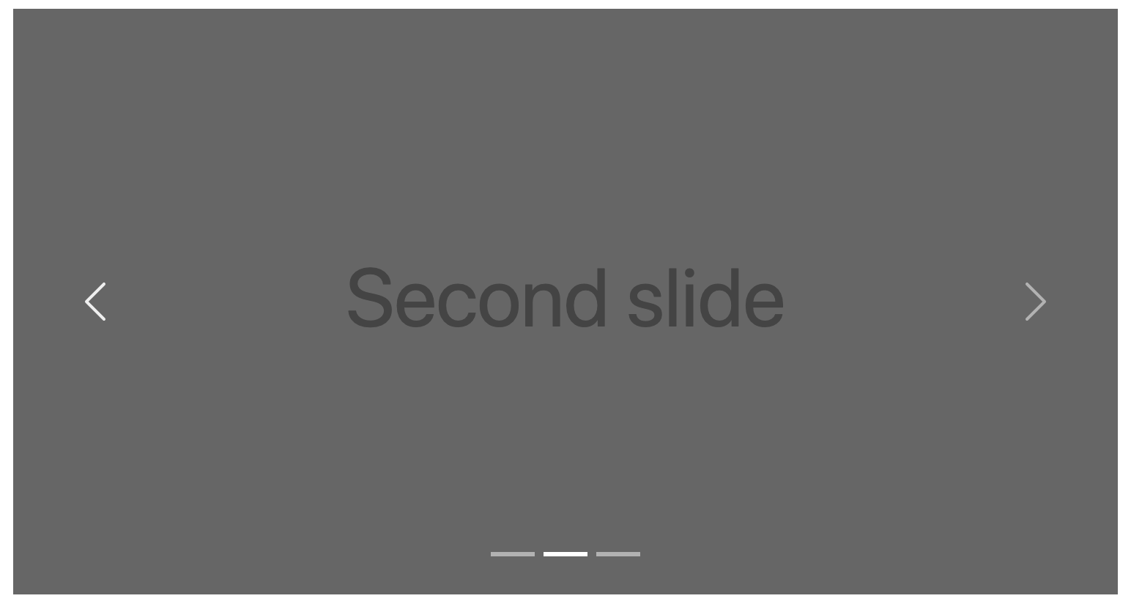
With indicators

Slide 10
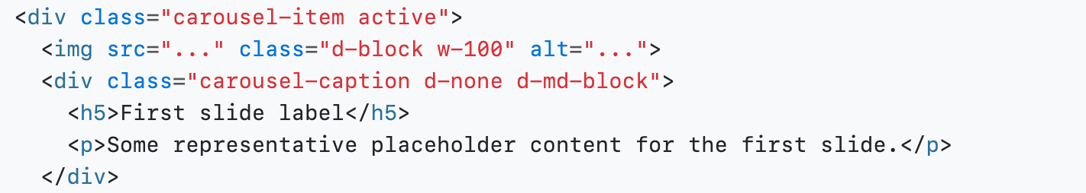
With captions
Add captions to your slides easily with the .carousel-caption element within any .carousel-item. They can be easily hidden on smaller viewports, as shown below, with optional display utilities . We hide them initially with .d-none and bring them back on medium-sized devices with .d-md-block.
Just add: <div class="carousel-caption d-none d-md-block">
<h5>First slide label</h5>
<p>Some representative placeholder content for the first slide.</p> </div>
after the image tag. For example,

Slide 11
With captions
To make the items with cross fade effect, we can add: “carousel-fade” class next to “slide” class. Source code: <div id="carouselExampleFade" class="carousel slide carousel-fade" data-bs-ride="carousel"> </div>

Slide 12
Individual .carousel-item interval
Add data-bs-interval="" to a .carousel-item to change the amount of time to delay between automatically cycling to the next item.
For example,
<div class="carousel-item active" data-bs-interval="10000">
<img src="..." class="d-block w-100" alt="...">
</div>

Slide 13
Disable touch swiping
Carousels support swiping left/right on touchscreen devices to move between slides. This can be disabled using the data-bs-touch attribute. The example below also does not include the data-bs-ride attribute and has data-bs-interval="false" so it doesn’t autoplay.
<div id="carouselExampleControlsNoTouching" class="carousel slide" data-bs-touch="false" data-bs-interval="false"> </div>

Slide 14
Dark variant
Add .carousel-dark to the .carousel for darker controls, indicators, and captions. Controls have been inverted from their default white fill with the filter CSS property. Captions and controls have additional Sass variables that customize the color and background-color.
<div id="carouselExampleDark" class="carousel carousel-dark slide" data-bs-ride="carousel"> </div>

